Slide 1



Welcome!
povertyalliance.org/CPW
#ChallengePoverty
7 - 13 October 2024
#CPW24
#ChallengePoverty
#CPW24
povertyalliance.org/CPW

Slide 2
Making the news
povertyalliance.org/CPW
#ChallengePoverty
7 - 13 October 2024
#CPW24
#ChallengePoverty
#CPW24
povertyalliance.org/CPW

Slide 3
Why use the media?
Raise public awareness
Influence change
Increase your profile
povertyalliance.org/CPW
#ChallengePoverty
7 - 13 October 2024
#CPW24
#ChallengePoverty
#CPW24
povertyalliance.org/CPW

Slide 4
Scotland’s news media
National newspapers
National TV news
Regional newspapers
National radio
Local newspapers
Local radio
povertyalliance.org/CPW
#ChallengePoverty
7 - 13 October 2024
#CPW24
#ChallengePoverty
#CPW24
povertyalliance.org/CPW
Notes:
What examples can you think of in each category? Write on sticky note. Put on wall. Discussion – which ones will get you the most audience? Which ones will be easier to get into? Which ones are right for the audience you’re trying to reach?

Slide 5
What do journalists want?
T R U T H
Timely
Real
Unique
Topical
Human
povertyalliance.org/CPW
#ChallengePoverty
7 - 13 October 2024
#CPW24
#ChallengePoverty
#CPW24
povertyalliance.org/CPW
Notes:
Journalists want something that is:
T- Timely – no point telling them too late
R- Real – journalists and reporters deal with facts- statistics, figures that can prove your shop’s worth or things that are happening
U- Unique/ Quirky/ different/ unusual
T - Topical-– is your story about something local, happening in your area? Or is it about a current theme or issue?
H- Human- every story is about people- the human factor- so it should not be difficult to talk

Slide 6
Making contact
Explore your local media
Get to know a journalist
Keep in touch
povertyalliance.org/CPW
#ChallengePoverty
7 - 13 October 2024
#CPW24
#ChallengePoverty
#CPW24
povertyalliance.org/CPW
Notes:
Do any of you know any journalists? Do you buy your local paper? If you don’t already, either go to your newsagents and get one or look for free in your library. Look at the kinds of stories they run, look for bylines (the name of the journalist who wrote the story) so you can aim your ideas at the right person. Find out what day the paper comes out and when their deadline for stories is, you can call and ask for this info. Don’t be afraid to call the journalists and ask for information or advice like this. If they’re not busy, they’ll usually be glad to help. You, your colleagues, friends and family are their readers. But the more homework you’ve done, the easier you’ll find it, eg asking for a journo by name, suggesting where in the paper your story could run.
Your local newspaper should be your first port of call. If you’ve got something sensational you think could make the national media, contact me and I’ll look into helping you place it. BBC and STV both have local divisions online that are desperate for local stories. They’ll want videos or pics to go with it though.
Once you’ve made contact with a journalist, keep in touch but don’t pester them. An email or phone call every week or 2 to keep them up to date with on-going activities is fine if they show interest but otherwise keep it restricted to your news releases. Hopefully though you’ll build a relationship with them. Invite them to events. Put them on your mailing lists.

Slide 7
News releases
Essential when dealing with the media
Keep it simple and easy to understand
Include your key messages, near the top
Choose your line and make it interesting
Always include your contact details
povertyalliance.org/CPW
#ChallengePoverty
7 - 13 October 2024
#CPW24
#ChallengePoverty
#CPW24
povertyalliance.org/CPW
Notes:
News Releases are essential for dealing with the media. They are what a journalist will ask for if they don’t have much time, they will often use the press release as copy and it is always good to refer to yourself. It gives everyone involved a chance to agree on what you are saying publicly, keeps a record of what you have said and journalists will know what to expect. Given all of this there are a few guidelines to writing a press release:
Make sure that anybody who picks up the press release can understand what is on the page. Try to avoid using jargon or technical terms unless essential to the press release, and then make sure you put a note at the end explaining what the term means.
POINT: Ask if any participants knows what a press release is and how to make one.
Key message are the main things that you are trying to communicate. An easy way to decide what your key messages are to summarise the stunt/event and why you are doing it in 3 lines or less. The more succinct the more punch they pack. Make sure they go near the top of the page. If a rushed journalist is only glancing at the first few lines of each press release they see, you want to make sure they have read what it is you are trying to say.
This is the most important part! YOU MUST INCLUDE YOUR CONTACT DETAILS, or you will never know if journalists are trying to get in touch to come to your event or arrange an interview. Also if they have any queries they will contact you, so if they can’t get in contact they may drop the story or worse, print incorrect information.

Slide 8

Model news
release
povertyalliance.org/CPW
#ChallengePoverty
7 - 13 October 2024
#CPW24
#ChallengePoverty
#CPW24
povertyalliance.org/CPW
Notes:
an embargo allows you to keep control over when your story is publicised and gives journalists a date to work to. No coverage can appear until the date and time you specify.
The heading should be typed in bold and centred. Keep it short, snappy and to the point.
Start with a bang. Get the five W’s in straight away – Who, When, What, Where, Why
Make your points in order of importance. The second paragraph should elaborate on the first one. You are essentially telling a story, so you must give the reader the full picture. Spell out the facts, give statistics, quote names and numbers of people involved.
Include a direct quote from the most relevant person involved, it will humanise the story. Keep the quote brief, providing an overview of the event. If writing a quote for somebody else, get their approval before using it. Remember to give the person’s full name and job title.
If the press release spreads to a second page type "more follows" at the bottom right hand corner and "continued" at the top of the second page. Never split paragraphs or sentences.
Contact: Give names and telephone numbers of people a journalist can contact for further information.
This is your last chance to give journalists details of how they can get copies of a report, photograph or any other information.
EXERCISE: Hand out the cut up press releases to each group. They should receive both press releases, cut up at each paragraph, mixed together. Ask the participants to put the cut up pieces of paper in the order they think best for a press release, sorting out which paragraphs belong to which press release. The added challenge is that they are not allowed to speak while the complete the task.

Slide 9

Broadcast news
povertyalliance.org/CPW
#ChallengePoverty
7 - 13 October 2024
#CPW24
#ChallengePoverty
#CPW24
povertyalliance.org/CPW
Notes:
Think about broadcast journalism. Remember that television needs something interesting to film. Radio interviews are often done over Zoom or through voice clips on WhatsApp.

Slide 10
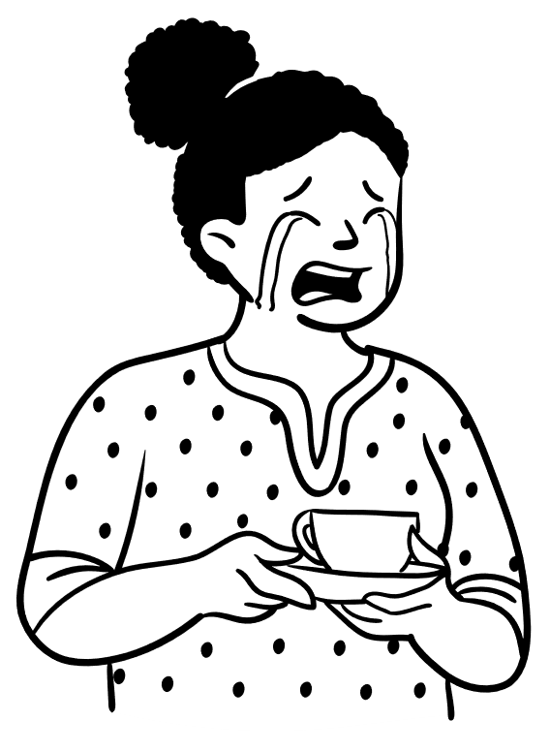
Stay positive!
povertyalliance.org/CPW
#ChallengePoverty
7 - 13 October 2024
#CPW24
#ChallengePoverty
#CPW24
povertyalliance.org/CPW
Notes:
16. If your press release isn’t used, don’t be disheartened. You won’t win every time and the best way to deal with this is, if you get the opportunity, ask the journalist why it didn’t appear. The most common answer will be lack of space or missing the paper’s deadline but it may be that you haven’t phrased your amazing press release right or made it clear enough. Ask for feedback and what kind of stories they’d be interested in or how you can hone your media work to make sure it has the best chance of getting used. Journalists will share this info, if they have thoughts or opinions on it, they’ll share them.
The joy – and the pure hard slog – of journalism is it has to be reinvented every single day. So there is always going to be another chance to place something else.

Slide 11
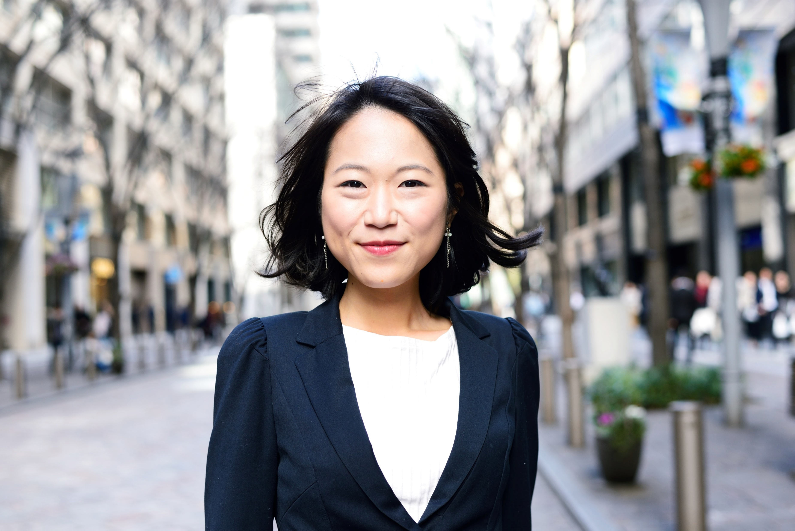
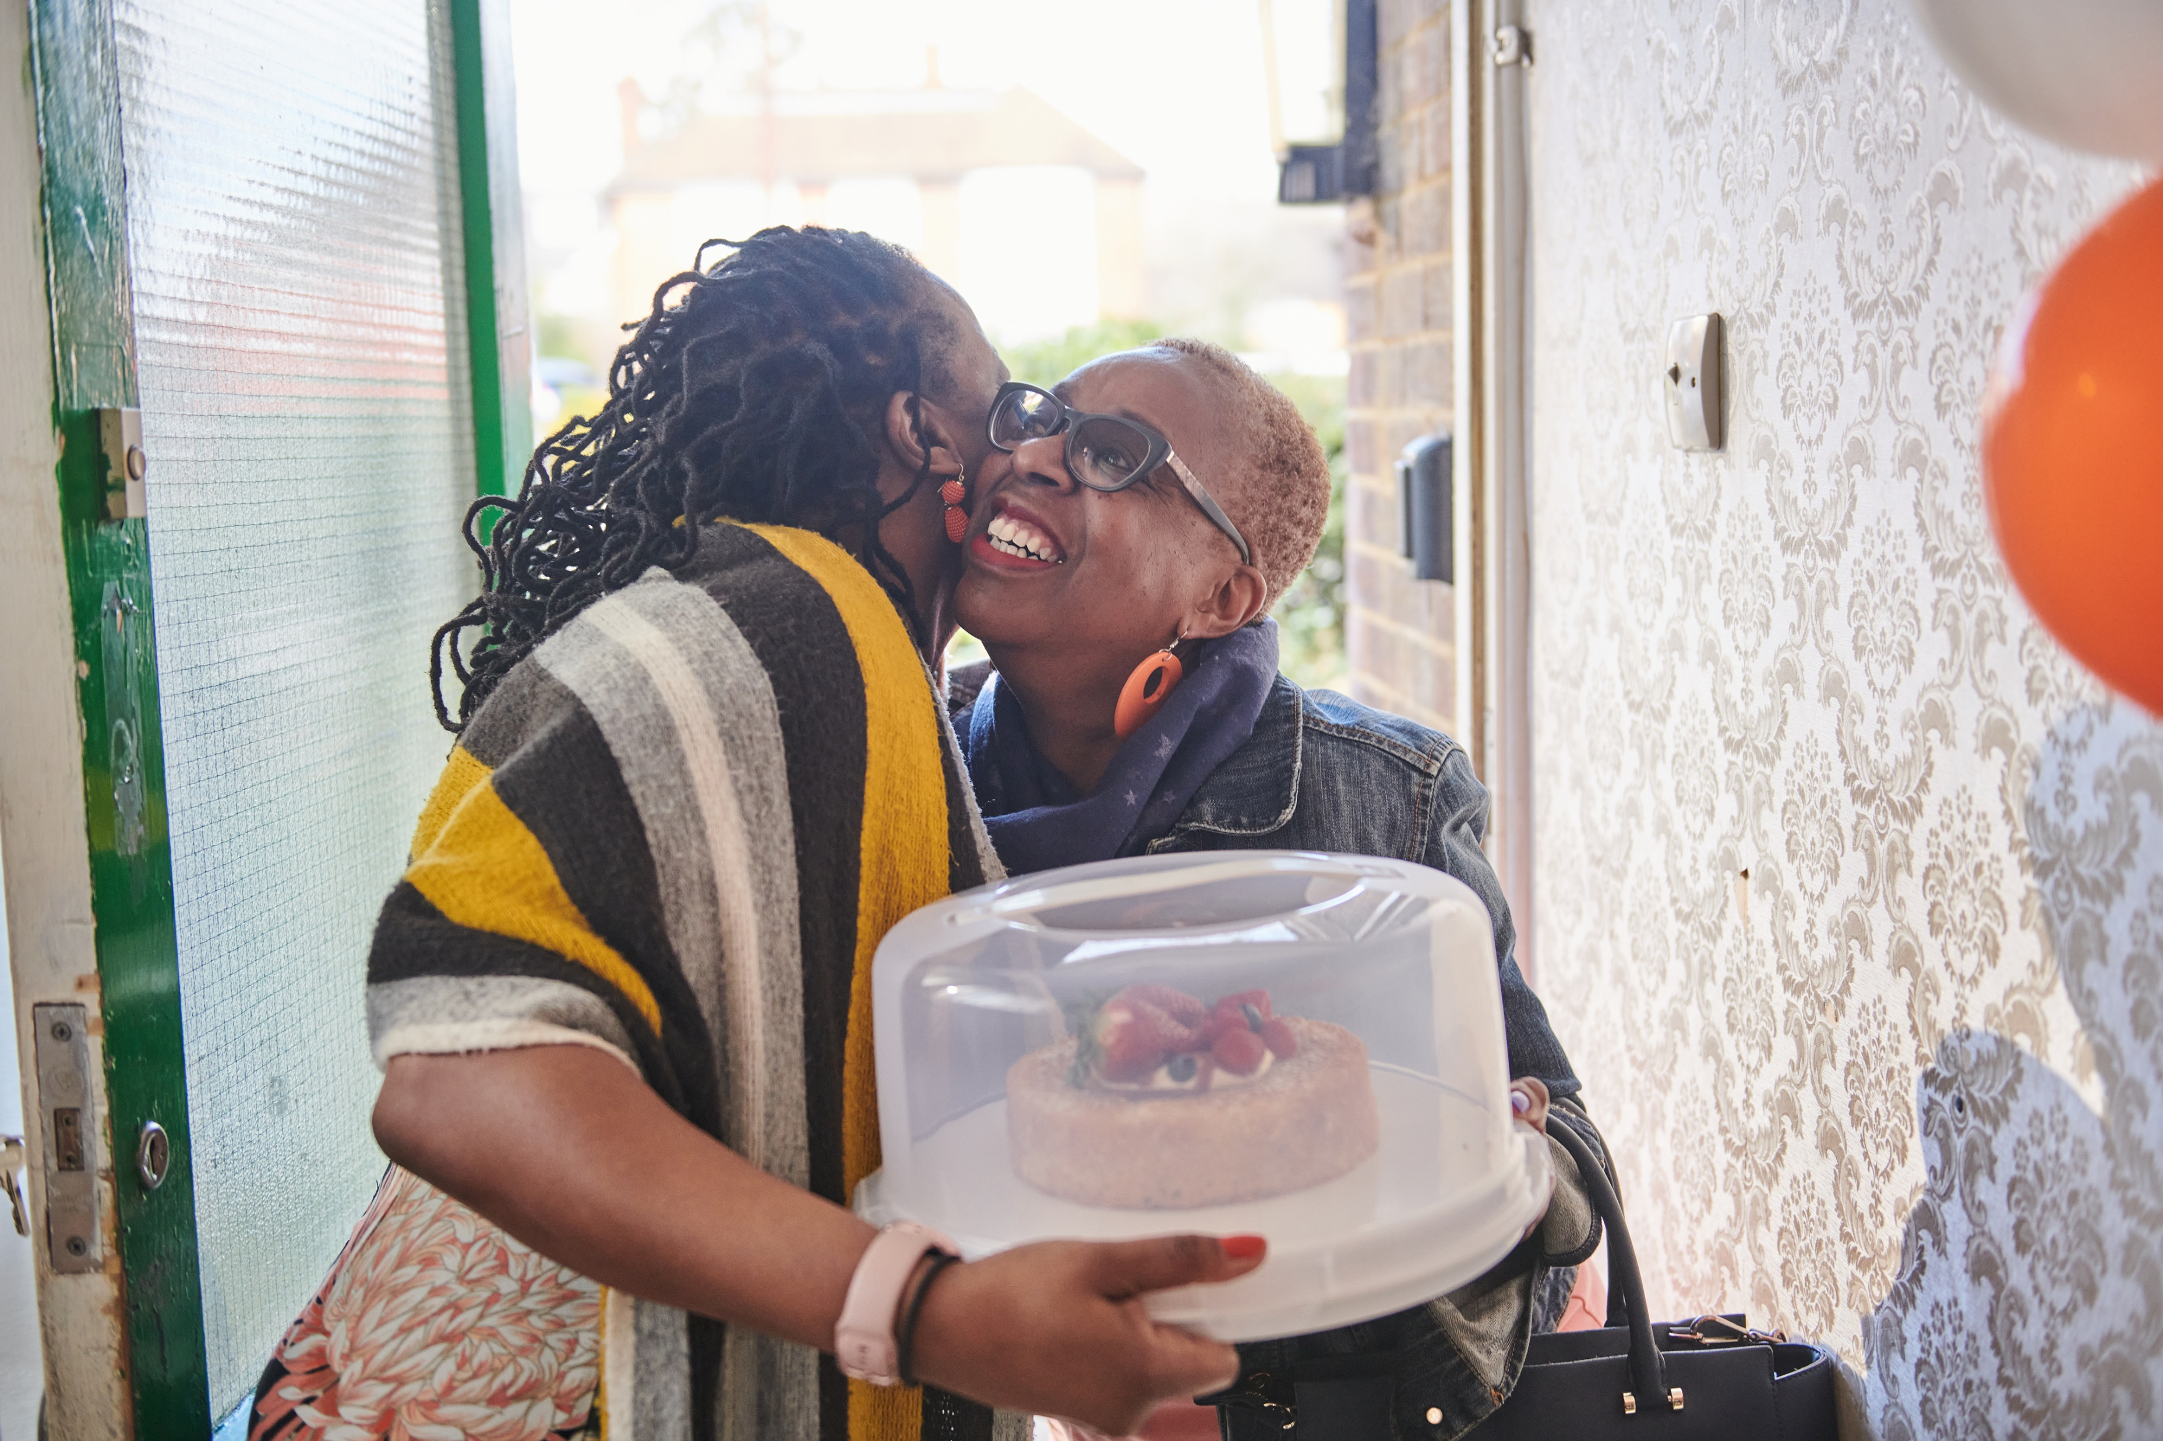
Take photos!
povertyalliance.org/CPW
#ChallengePoverty
7 - 13 October 2024
#CPW24
#ChallengePoverty
#CPW24
povertyalliance.org/CPW
Notes:
A few words on pics. If you’re selling something an event, you’ll be asked if you have pics of it. No-one expects you to be an expert but a few simple tips might help: remember the rule of thirds, check the light, focus and keep it tight – no pillars or lampposts or trees coming out of heads. And if you’re taking the pics, make sure you have permission of the people in them to use them in the media – children in particular have to have consent.

Slide 12
So now you know!
Identify your target media
Find journalists worth talking to
Create a press release
Sell it in
povertyalliance.org/CPW
#ChallengePoverty
7 - 13 October 2024
#CPW24
#ChallengePoverty
#CPW24
povertyalliance.org/CPW

Slide 13



Thanks!
david.eyre@povertyalliance.org
povertyalliance.org/CPW
#ChallengePoverty
7 - 13 October 2024
#CPW24
#ChallengePoverty
#CPW24
povertyalliance.org/CPW

